Slide 1

Software Reuse & Refactoring
By: Matthew Merricks
Brian Smith
Ryan Waggoner

Slide 2

Overview of Presentation
Introduction
Software Reuse
Software Refactoring
Benefits and Problems with Software Reuse and Refactoring
Conclusion

Slide 3
Introduction
Increase in demand for software = Need for quicker and more cost effective strategies for software development

Slide 4
Software Reuse
Opportunistic Reuse – Unplanned Reuse that is realized to be beneficial once a project has started.
  Internal Reuse – When programmers reuse their own code.
  External Reuse – When programmers make use of code others have written.
Planned Reuse – When code is written with intention to be used in the future.

Slide 5
Types of Software Reuse
Abstraction - describes initial methods and definitions for the programmers to be able to build upon to achieve their objectives.
Software Product Line - analyzes the objectives and plans for the code to be functional as well as adaptable and capable of evolution.

Slide 6
Types of Software Reuse
Cut-and-Paste Programming - code is simply taken directly from one program and copied straight into another program.
Generic Programming - deliberately writes fairly ambiguous code that can be adjusted by the programmer to suit their intentions.

Slide 7
Benefits of Reuse
Saves time, money, resources.
Allows for the growth and maximization of code.
Code can be analyzed and improved when time comes to be re-written.
Popular method used in marketing and can be profitable for businesses.

Slide 8
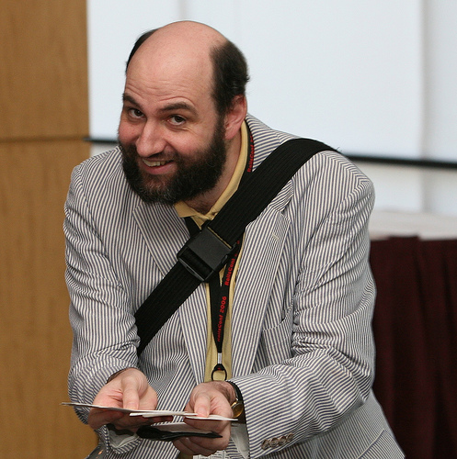
Software Refactoring
Invented by Martin Fowler:

Slide 9
Software Refactoring
Fowler says, “Refactoring is a disciplined technique for restructuring an existing body of code altering its internal structure without changing its external behavior.”

Slide 10
Software Refactorings
Extract Method – takes a clump of code and turns it into a method
Inline Method – takes a method and replaces it with a body of code
Inline Temp – replaces all instances of a temp method with the original method

Slide 11
Software Refactorings
Introduce Explaining Variable – places a complicated expression in a temporary variable
Split Temporary Variable – renames a variable that is assigned more than once
Remove Assignment Parameters – assigns parameters to a temporary variable

Slide 12
Software Refactorings
Replace Method with Method Object – turns a method into an object so that the object can be decomposed into different methods
Substitution Algorithm – substitutes an algorithm with a clearer algorithm

Slide 13
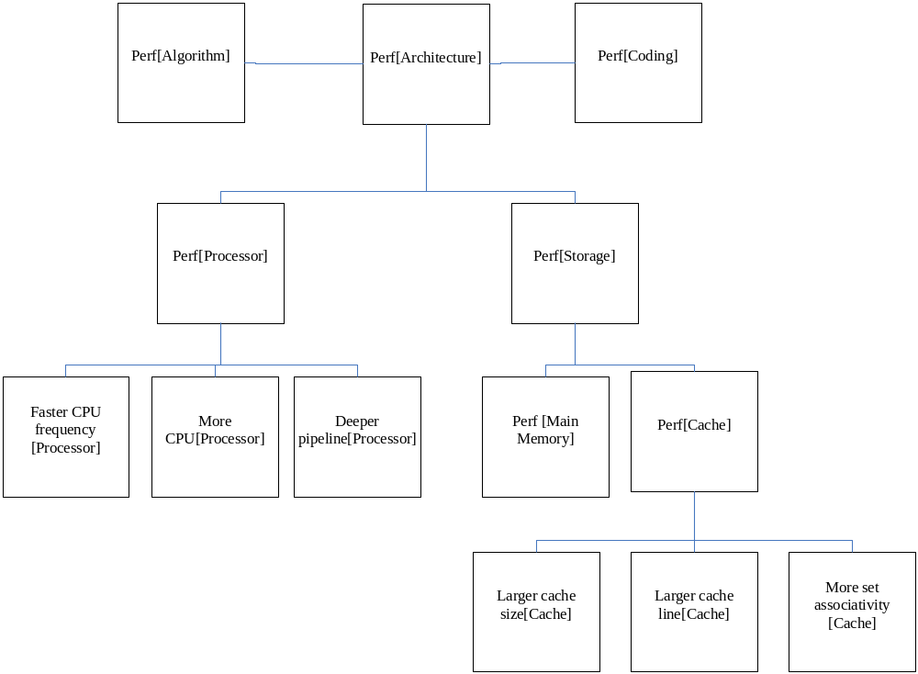
Time Performance Break Down

Slide 14
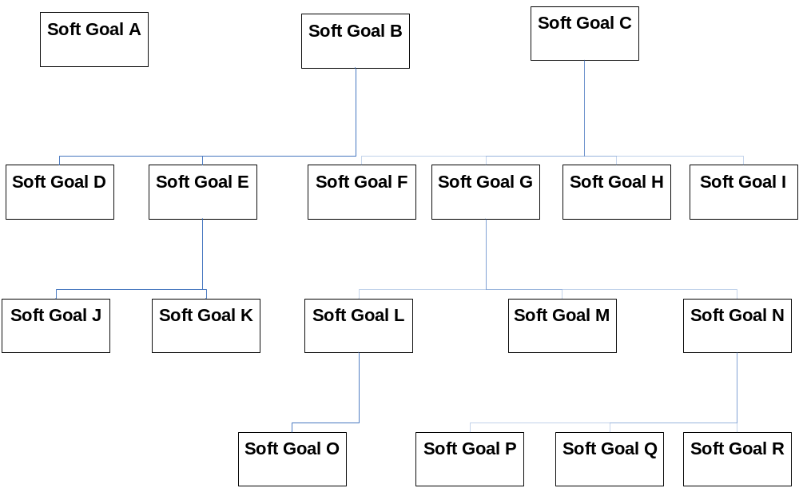
Soft Goal Example

Slide 15
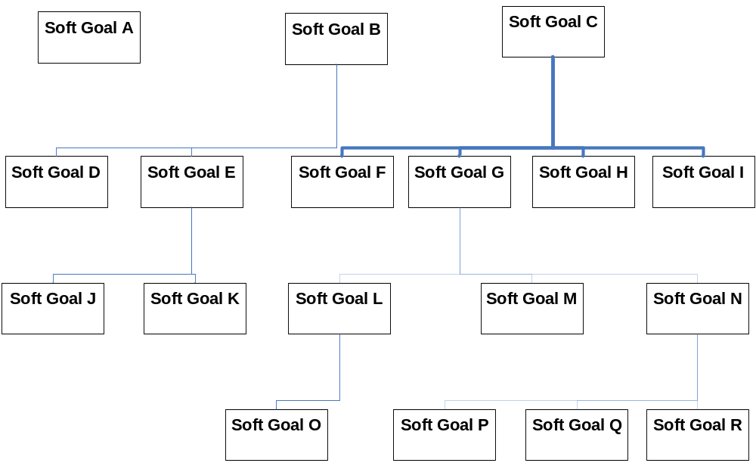
Soft Goal Example

Slide 16
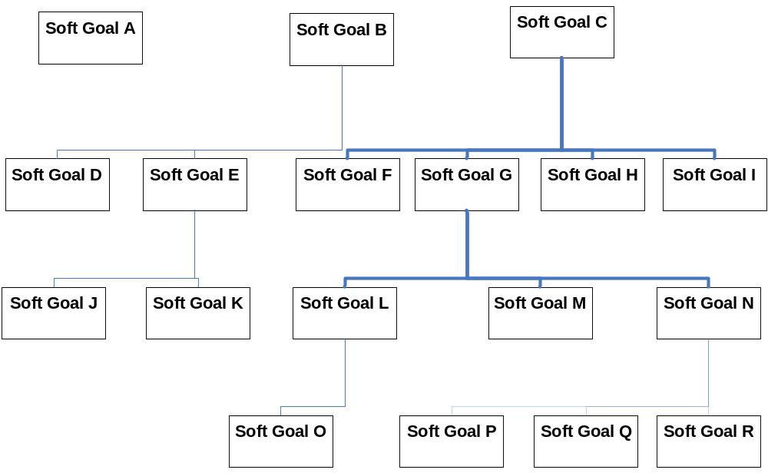
Soft Goal Example

Slide 17
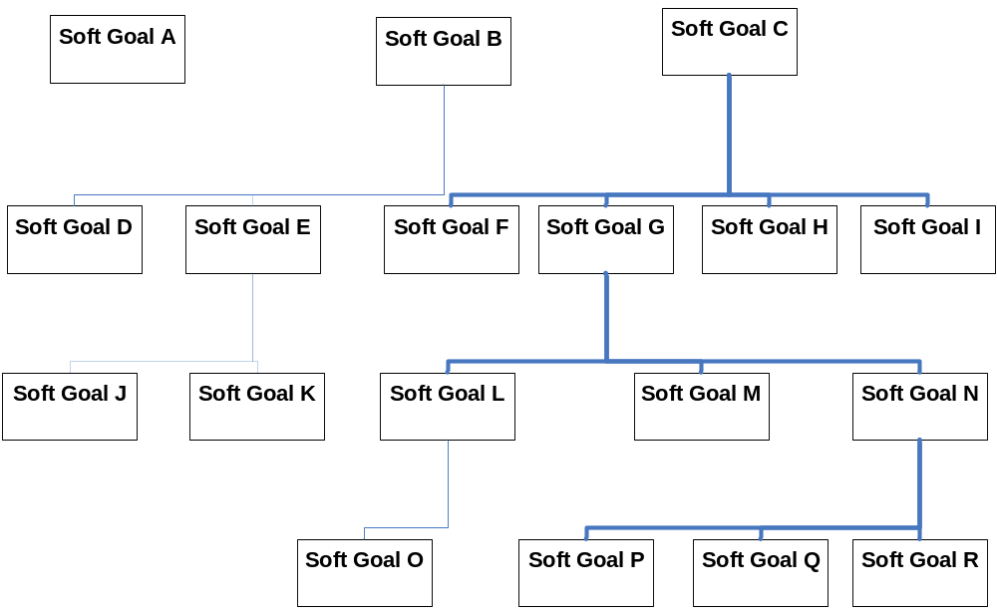
Soft Goal Example

Slide 18
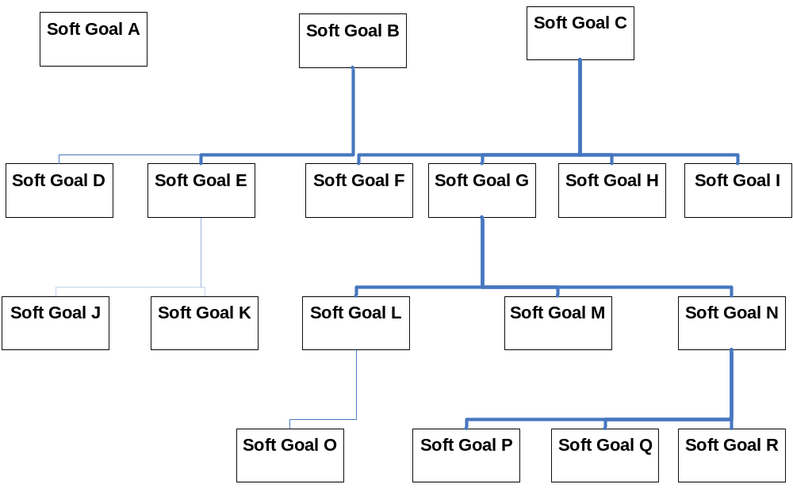
Soft Goal Example

Slide 19
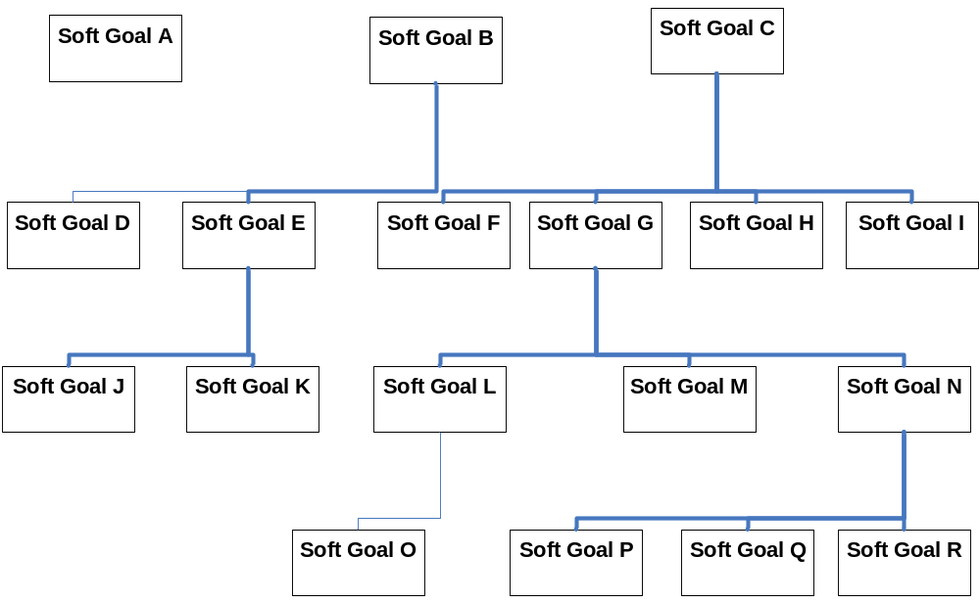
Soft Goal Example

Slide 20
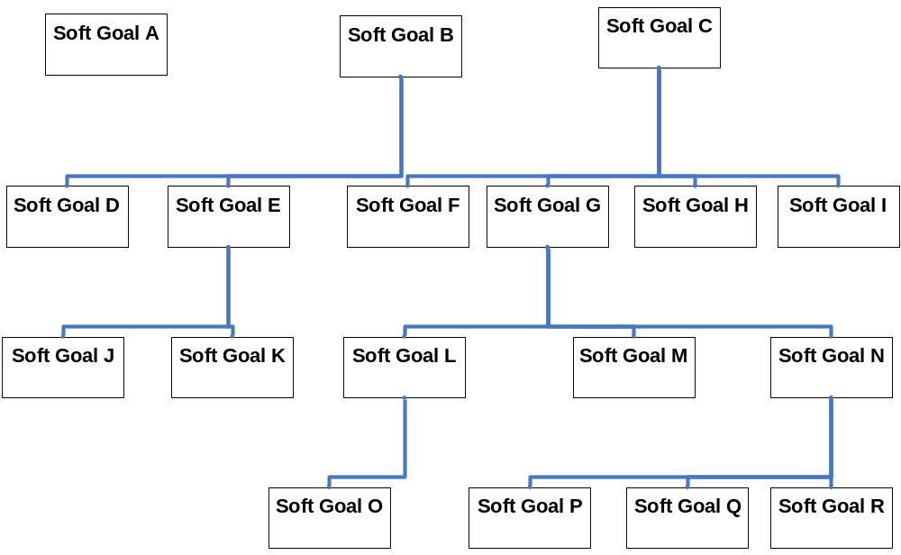
Soft Goal Example

Slide 21
Visual Works
Smalltalk IDE produced by Cincom
Features Smalllint, a style checker and bug detector
Support continuous modifications
Can roll back to its initial state

Slide 22
Visual Works
High degree of safety due to dynamic checking and user input
Low effort tool because it can automate the modifying of code
Does not include metrics of any kind

Slide 23
Eclipse
Uses a Java Development Tool (JDT)
Uses partial recompilation
Supports continuous changes
A local application
Uses repositories to update code
Partially automated with the use of the Refactoring Wizard

Slide 24
Guru
Developed by Ivan Moore for the SELF
Used for restructuring inheritance hierarchies and refactoring methods
Automatic tool with no user interaction needed
Automatically generated object and method names

Slide 25
Guru
Very low effort tool
Highly invasive
Global application

Slide 26
Together Control Center
Created by TogetherSoft
Uses a refactoring menu
Is a refactoring tool and a development environment
Local application
Offers versioning and undo capabilities
Low effort tool

Slide 27
Facet | Visual Works | Eclipse | Guru | Control Center
Time of Change | T2, T3 | Before T1 or T2 After T3 | Before T1 or T2 After T3 | Before T1 or T2 After T3
Change History | Irrelevant | Parallel / Asynchronous | Unversioned | Versioned
Frequency | Continuously | Continuously | Occasionally | Continuously
Distribution | Local | Local | Local | Local

Slide 28
Facet | Visual Works | Eclipse | Guru | Control Center
Automation | Semi-Automatic | Semi-Automatic | Fully Automated | Semi-Automatic
Effect | Alteration | Any | Alteration | Any
Invasiveness | Non-Invasive | Non-Invasive | Highly Invasive | Non-Invasive
Effort | Low Effort | Low Effort | Virtually No Effort | Low Effort

Slide 29
Software Reuse: Benefits
Increased Dependability
Reduced Process Risk
Effective Use of Specialists
Standards Compliance
Accelerated Development

Slide 30
Software Reuse: Problems
Increased Maintenance Costs
Lack of Tool Support
Not-Invented-Here Syndrome
Creating and Maintaining a Component Library
Finding, Understanding and Adapting Reusable Components

Slide 31
Refactoring: Benefits
Improves Design of Software
Makes Software Easier to Understand
Helps in Finding Bugs
Helps to Program Faster (in the long term)

Slide 32
Refactoring: Problems
Lack of Software Quality Improvement
Unreliability of Refactoring Tools

Slide 33
Conclusion
Use Software Reuse and Refactoring
But not BLINDLY!

Slide 34
Works Cited I
Fowler, Martin. Refactoring: Improving the Design of Existing Code. Boston, MA: Addison-Wesley, 2000.
Fowler, Martin. “What is Refactoring?” Refactoring Home. 1 Nov. 2007 <http://www.refactoring.com/>.
Glynn, Erica, Strooper, Paul. “Evaluating Software Refactoring Tool Support” In Software Engineering Conference. 18-21 April 2006. Melbourne, Vic.
Jacobson, Ivar and Griss, Martin and Johsson, Patrik. "Software Reuse: Architecture, Process and Organization for Business Success." Addison-Wesley Professional(1997).
Lim, Wayve C. "Managing Software Re-Use." Prentice Hall PTR(1998).
Mealy, E., Carrington, D., Strooper, P., Wyeh, P. 2007. “Improving Usability of Software Refactoring Tools” In Software Engineering Conference. 10-13 April 2007. Melbourne, Vic. 307-318.

Slide 35
Works Cited II
Mens, Tom, and Tourwe, Tom. “A Survey of Software Refactoring.” IEEE Transactions on Software Engineering Vol. XX No. Y (2004) 1-3.
Mili, Hafedh and Mili, Ali and Yacoub, Sherif, and Addy, Edward. "Reuse-Based Software Engineering: Techniques, Organizations, and Controls." Wiley-Interscience(2001).
Mylopoulos, John, and Yu, Eric, and Yu, Yijun. “Software Refactoring Guided by Multiple Soft-Goals.” Not available.
Simmonds, J. and T. Mens, A comparison of software refactoring tools, Technical Report vub-prog-tr-02-15, Programming Technology Lab (2002).
Sommerville, Ian. Software Engineering. 8th ed. New York: Addison-Wesley, 2007. 63-91.
Spinellis, Diomidis, and Stroggylos. Konstantinos. “Refactoring – Does it Improve Software Quality?” Fifth International Workshop on Software Quality (2007) 1-4.

